Slide 1
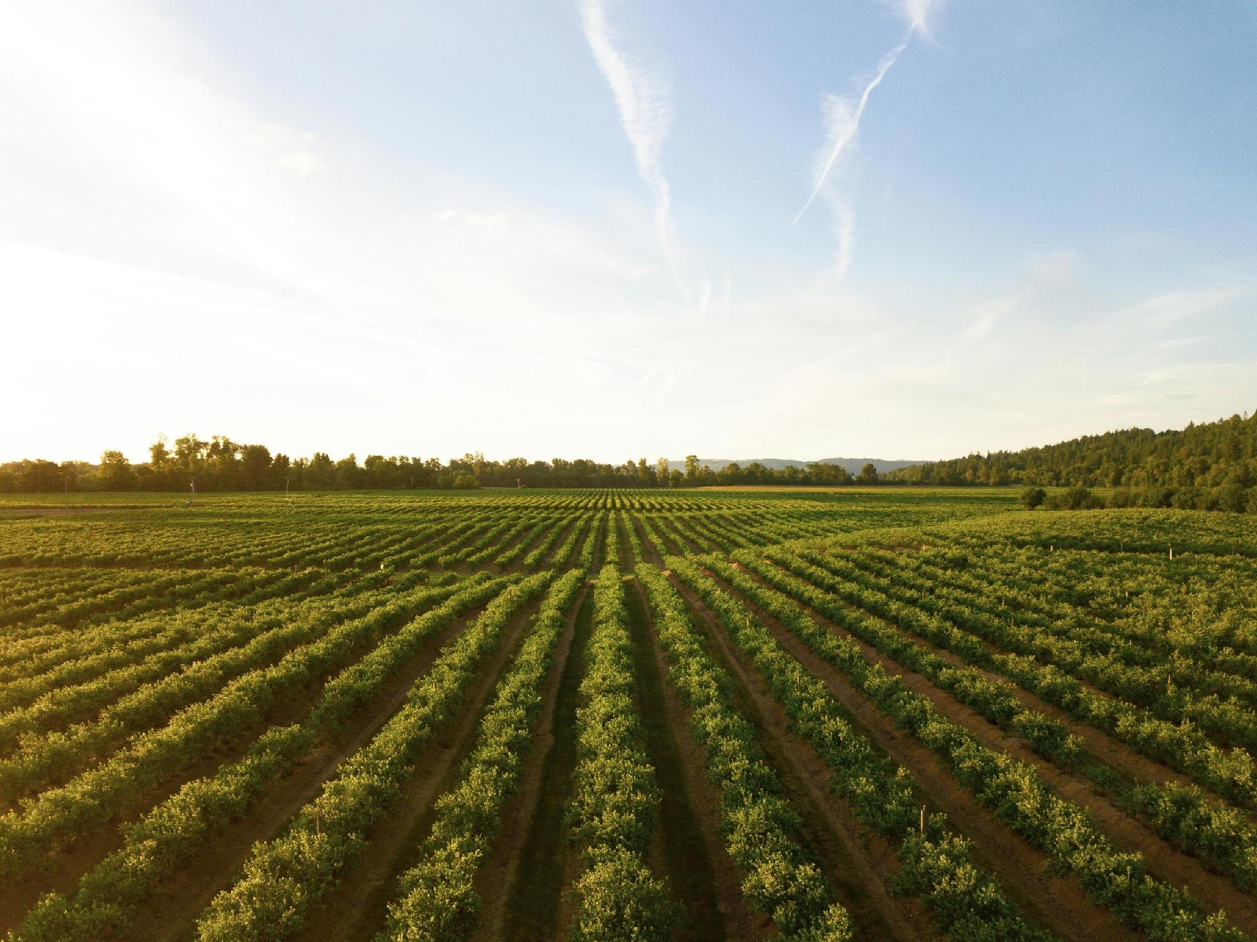






In technical module 2
System Modelling of Cold Room
Course delivered by: Bahareh Bakhsh Zahmatkesh
PhD Candidate in Thermal and Fluid Engineering, University of Twente, The Netherlands
 | Email: | bahareh.bakhshzahmatkesh@utwente.nl
 | LinkedIn: | www.linkedin.com/in/bahareh-zahmatkesh
 | GitHub: | https://github.com/B-BZ
AGRICOOL

Slide 2
What will you learn?
By the end of this session, participants will be able to:
Explain how dynamic system modelling supports off-grid cooling design.
Distinguish static worst-case sizing from dynamic performance assessment
Describe how Modelica and reusable libraries model physical systems..
Interpret simulation results to compare design and operating scenarios.
AGRICOOL

Slide 3
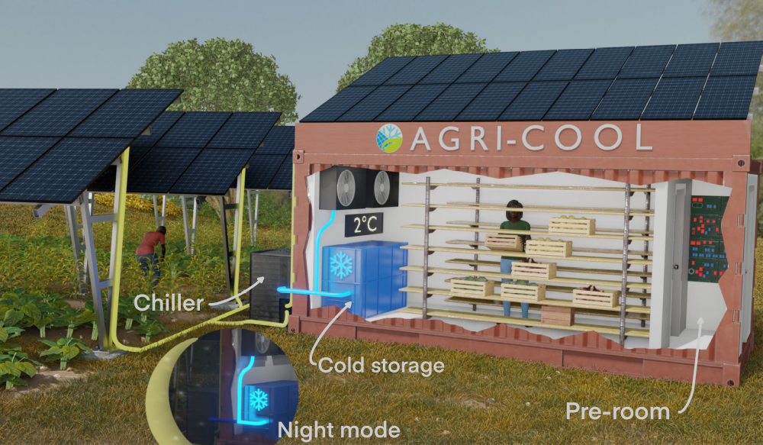
AGRI-COOL System
AGRICOOL

Slide 4
Worst-case design of an off-grid PV cold room
Define design conditions
Room target, crop loading, hot ambient, low-sun period and autonomy
Calculate cooling loads
Envelope + crops + infiltration + internal gains: peak kW and daily kWh
Size cooling and thermal storage
Air cooler, chiller and ice storage, including storage recharge
Size the electrical system
PV and inverter for power and energy needs, battery for autonomy
AGRICOOL
Check the complete design
Cooling capacity, daily energy and autonomy, then revise if needed
Notes:
conservative

Slide 5
What might the sizing assumptions miss?
Component capacity
Are we oversizing by assuming all peak loads occur together?
Electricity consumption
Are we overestimating energy use by assuming continuous full-load operation?
Usable solar energy
Are we overestimating how much PV energy the system can actually use?
AGRICOOL
Storage autonomy
Will the ice tank recharge sufficiently before nightfall?

Slide 6
Methodology
AGRICOOL

Slide 7
Dynamic System-Level modelling
Changing conditions
System response
Weather and sunlight
Crop arrivals
Other heat gains
Room and crop
temperatures
Storage state
Electricity use
Components + energy balances
+ control logic
AGRICOOL
Assess whether temperature requirements are met, day and night.

Slide 8

Modelica for dynamic system modelling
Our chosen language for describing connected physical systems
Equation-based
Use physical laws, such as energy conservation.
Write relationships. The tool solves them together.
Object-oriented and reusable
Keep equations, parameters and connectors together.
Multi-domain
https://modelica.org/
AGRICOOL
Connect thermal, fluid, electrical and control models.

Slide 9
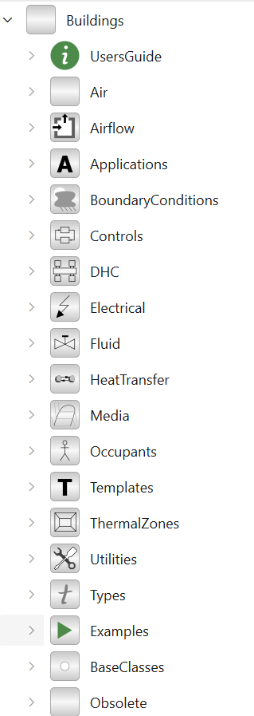
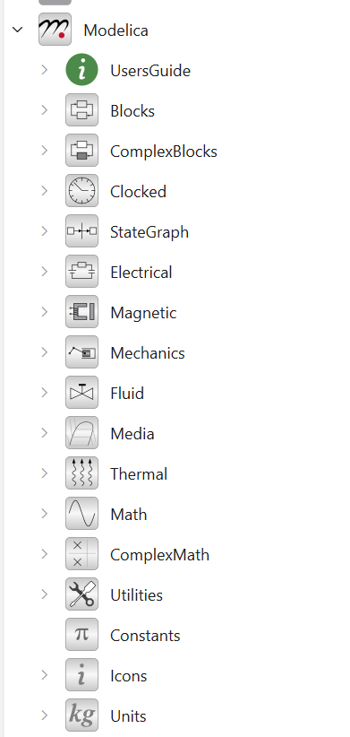


Open tools and reusable libraries
OpenModelica is where we assemble, simulate and plot the model.
Modelica Standard Library
Heat transfer, basic components
and control blocks
Our AgriCOOL model
Library components +
small custom models
Buildings library
Chiller, air cooler, pump, fan,
ice tank and weather reader
AGRICOOL
Modelica supplies the language. OpenModelica supplies the environment.
Open source lets us inspect equations, adapt components and share models.

Slide 10
Modelling AGRI-COOL Systems
AGRICOOL

Slide 11
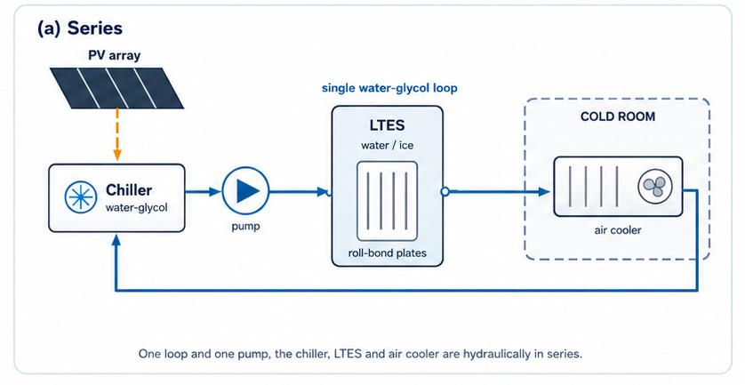
Our simplified AGRI-COOL system
One circulating brine loop exchanges heat with a separate room-air loop.
AGRICOOL

Slide 12
Where does the cooling demand come from?
AGRICOOL

Slide 13
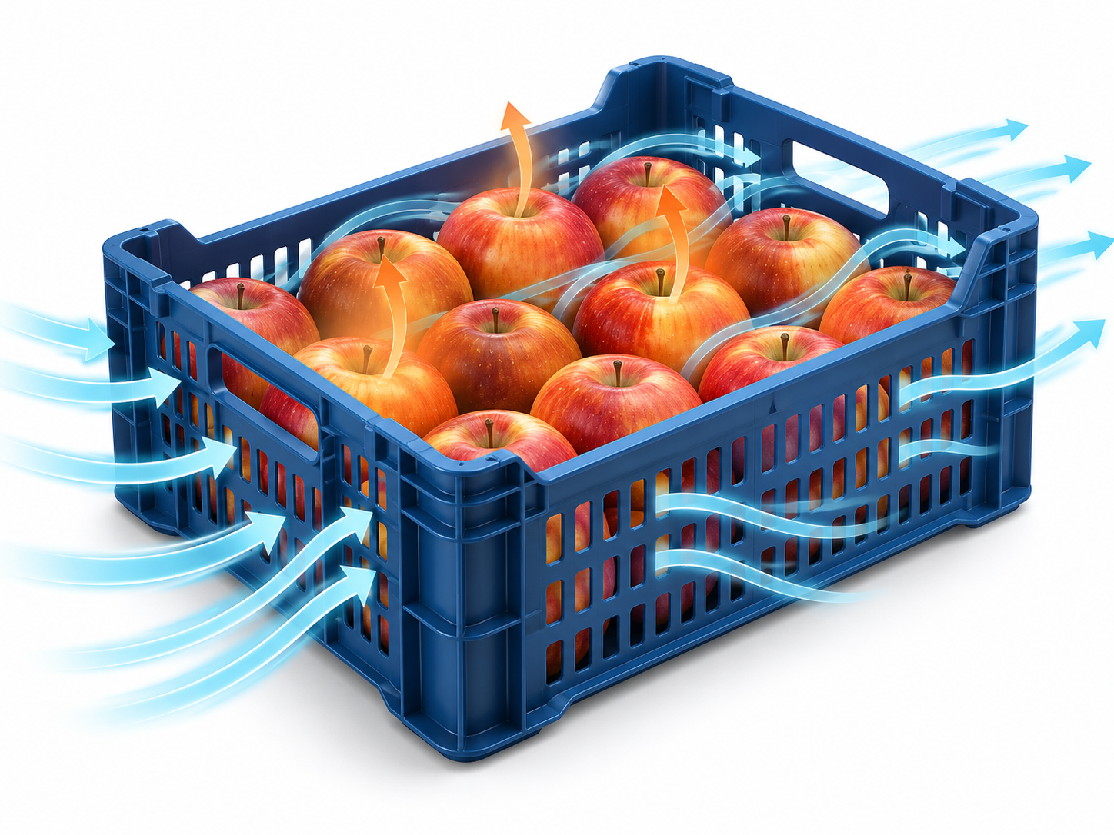

Crop batch: cooling and respiration
Warm produce cools gradually.
Respiration generates heat.
Model: one temperature per batch,
with no moisture loss.
CROP ENERGY BALANCE
$$mc_{p}\frac{dT_{p}}{dt}=UA(T_{r}−T_{p})+mq_{resp}$$
AGRICOOL
m: crop mass cₚ: specific heat Tₚ: crop temperature Tᵣ: room temperature
UA: effective thermal conductance qᵣₑₛₚ: respiration heat per kilogram

Slide 14
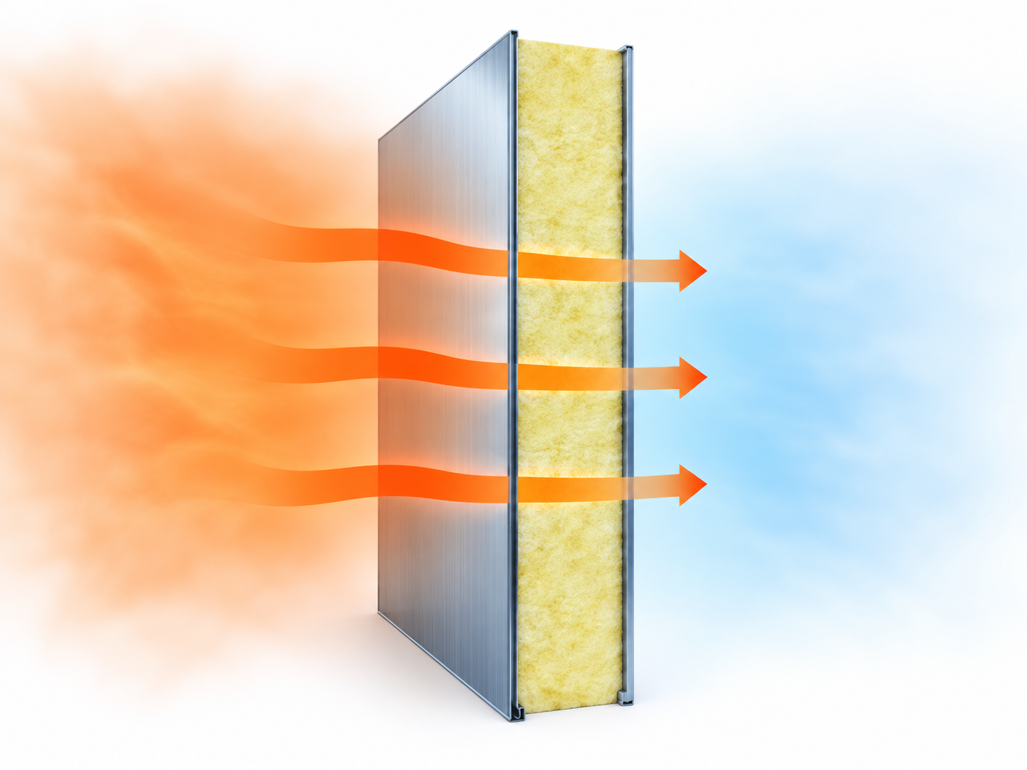

Envelope: heat transmission and storage
Warm ambient
Cold room
Insulation slows heat flow.
The wall mass stores heat.
Model: one wall temperature,
with a resistance on each side.
WALL ENERGY BALANCE
$$C_{w}\frac{dT_{w}}{dt}=\frac{T_{a}−T_{w}}{R_{o}}−\frac{T_{w}−T_{r}}{R_{i}}$$
AGRICOOL
Temperatures: ambient (a), wall (w), room (r)
C: wall heat capacity R: outer (o) and inner (i) thermal resistance

Slide 15
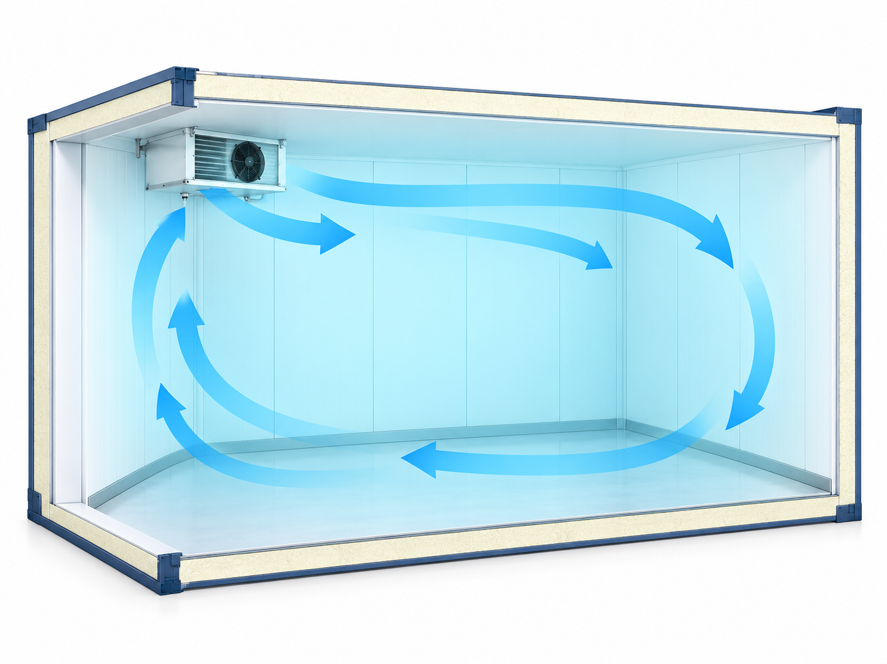

Room air: one well-mixed volume
Heat gains warm the room.
The fan coil removes heat.
Model: one air temperature
represents the whole room.
ROOM ENERGY BALANCE
$$\frac{dU_{room}}{dt}={\dot{Q}}_{wall}+{\dot{Q}}_{crop}+{\dot{Q}}_{other}−{\dot{Q}}_{cool}$$
AGRICOOL
U: room-air internal energy Q̇: heat-transfer rate
Other gains: infiltration, lighting and people

Slide 16
Producing, transferring and storing cooling
AGRICOOL

Slide 17
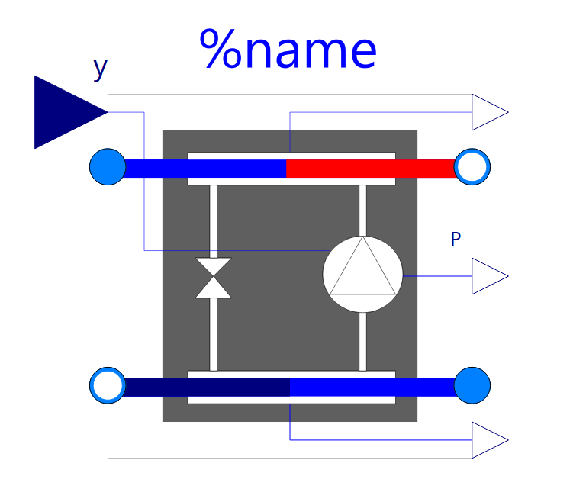
Chiller: producing cooling
Buildings.Fluid.Chillers.Carnot_y
P_comp
Brine inlet
T_in, ṁ, cₚ
Brine outlet
T_out
Electrical power drives
heat removal from brine.
Evaporator
COP depends on operating
temperatures and part load.
Condenser
Heat-rejection
fluid inlet
Heat-rejection
fluid outlet
$${Q̇}_{cool}=COP.P_{comp}$$
AGRICOOL
$${Q̇}_{cool}≈ṁc_{p}(T_{in}−T_{out})$$
Cooling is positive here. The brine temperature balance assumes negligible fluid energy storage.

Slide 18
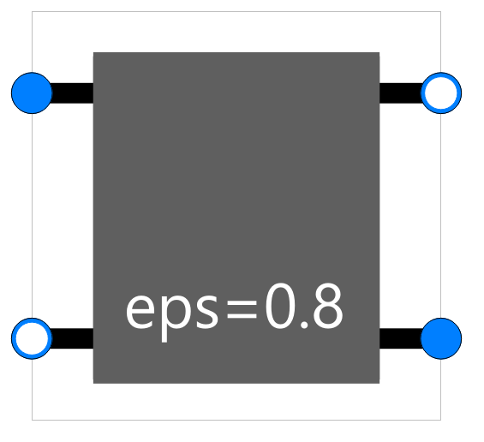
Air cooler: transferring heat
Buildings.Fluid.HeatExchangers.ConstantEffectiveness
Air inlet
T_air,in, ṁ_air
Air outlet
T_air,out
Heat moves from room air
to the colder brine.
Q̇_cool
Effectiveness and fluid flows
determine the heat transfer.
Brine outlet
T_brine,out
Brine inlet
T_brine,in, ṁ_brine
$${Q̇}_{cool}=εC_{min}(T_{air,in}−T_{brine,in})$$
AGRICOOL
$$C_{min}=min({ṁ}_{air}c_{p,air},{ṁ}_{brine}c_{p,brine})$$
ε: effectiveness C: heat-capacity rate [W/K] Dry, sensible heat transfer only.

Slide 19
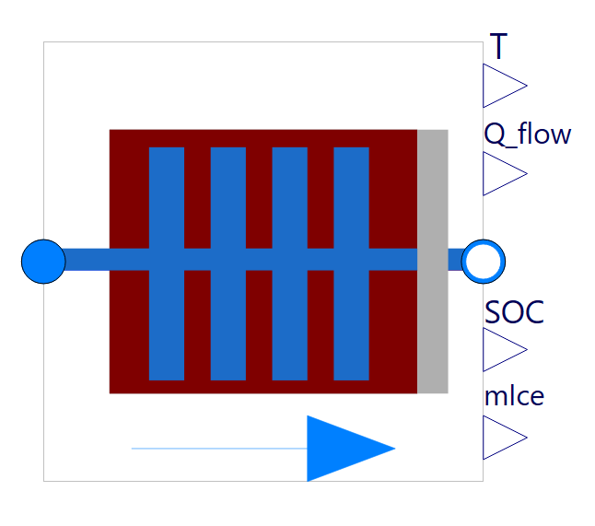



Ice tank: storing cooling
Buildings.Fluid.Storage.Ice.Tank
Water + ice
Freezing stores cooling.
Melting releases it.
m_PCM, SOC
Brine inlet
T_in, ṁ, cₚ
Brine outlet
T_out
Charging: T_out > T_in
Discharging: T_out < T_in
Embedded coil
$$E_{max}=m_{PCM}L$$
$$E_{max}\frac{dSOC}{dt}={Q̇}_{charge}=ṁc_{p}(T_{out}−T_{in})$$
AGRICOOL
$${Q̇}_{charge}=E_{max }.q^{∗}(SOC,∆T)$$
m_PCM: total water/ice mass L: latent heat SOC: ice fraction Q̇_charge: signed charging rate.

Slide 20
Supplying and storing electricity
AGRICOOL

Slide 21
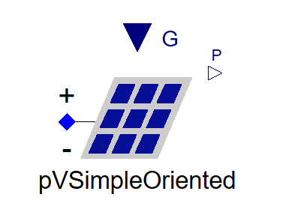
PV: generating electricity
Simplified PV power model
Sunlight: G
PV supplies electricity
for cooling and auxiliaries.
P_PV
η_PV and f
Production changes with
irradiance on the panels.
Panel area A
$$P_{PV}=G.A.η_{PV}.f$$
AGRICOOL
G: irradiance on the panel plane A: panel area η_PV: efficiency f: derating factor.

Slide 22
System Integration
AGRICOOL

Slide 23
Different Media and Domains in the model
PV
BRINE
Pump
Chiller
Air cooler
Ice tank
AGRICOOL
Cold room
air + envelope + crops
Fan
ROOM AIR

Slide 24
Control of the off-grid cooling system
Three simple rules: the sun decides when the chiller runs, the room decides the fan speed, the ice tank needs no control
1 CHILLER — follows the sun
PV
enough?
PV power
P_PV
Yes
Follow PV
y = P_PV / P_nom
Soft start
Cold limit
throttle as brine
nears −5 °C
Compressor
runs at y
(≤ PV power)
No
Chiller OFF (y = 0)
2 FAN — follows the room
Room air
temperature T_room
PI controller
error = T_room − 6 °C
Limit
5 % … 100 % speed
Fan air flow
AGRICOOL

Slide 25
Modelica Package Structure
AGRICOOL

Slide 26
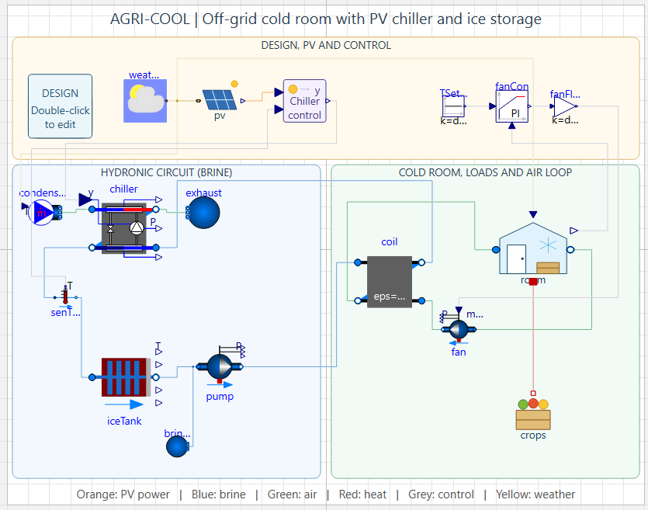

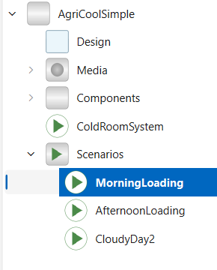
AGRI-COOL Modelica Model on Git Hub
Scan to clone.
AGRICOOL

Slide 27
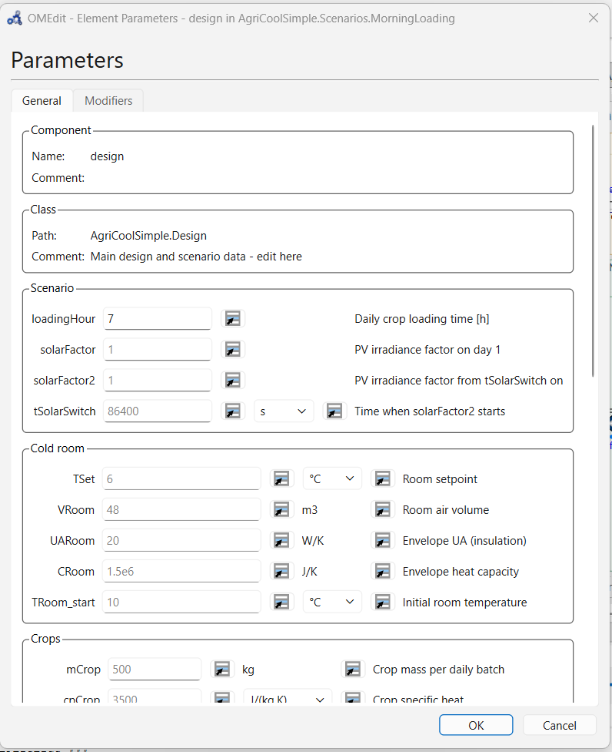
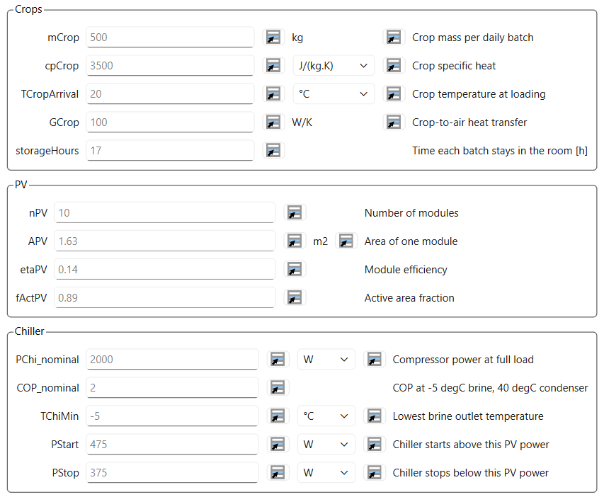
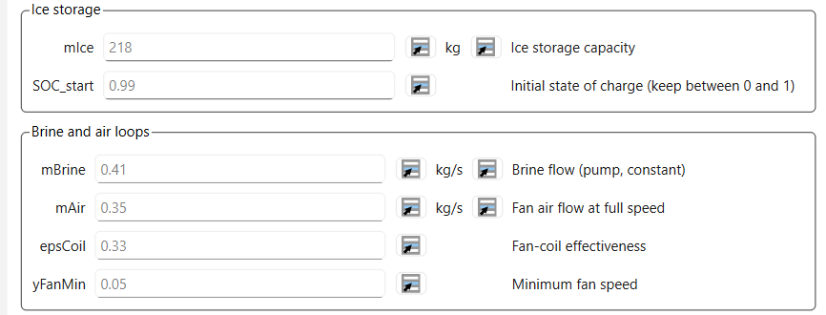
Record of Design Parameters
AGRICOOL

Slide 28


Testing Operating Scenarios
Loading Time Sensitivity:
Morning vs. afternoon crop loading
PV Shortfall (Cloudy Day):
Reduced solar input vs. baseline
Component | Specifications
Cold Room | 50 m³ - Wall UA = 20 W/K, Room setpoint 6 °C
Daily Crop Load | 500 kg/day at 20 °C - cp = 3500 J kg⁻¹ K⁻¹, stored 17 hrs
PV System | 10 modules × 1.63 m², η = 18 %, ≈ 2.6 kW at 1000 W/m²
Chiller | 4 kW cooling capacity - glycol outlet −5 °C - PV-driven
LTES | 218 kg ice (≈ 20 kWh)
AGRICOOL

Slide 29
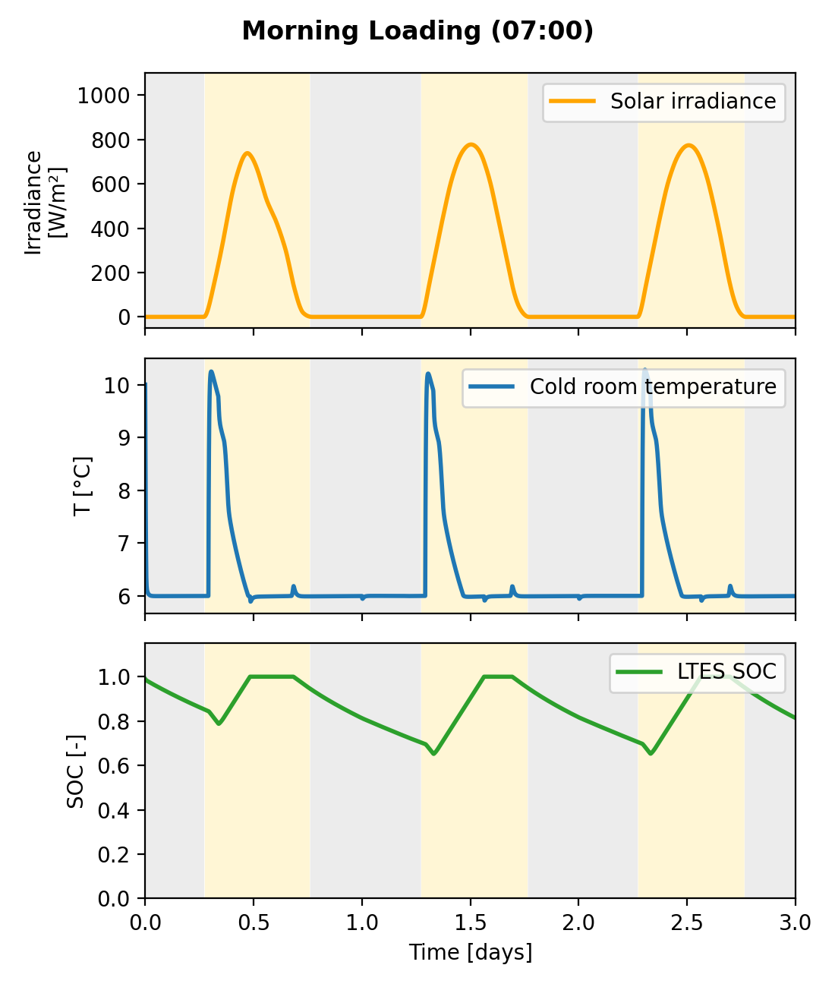
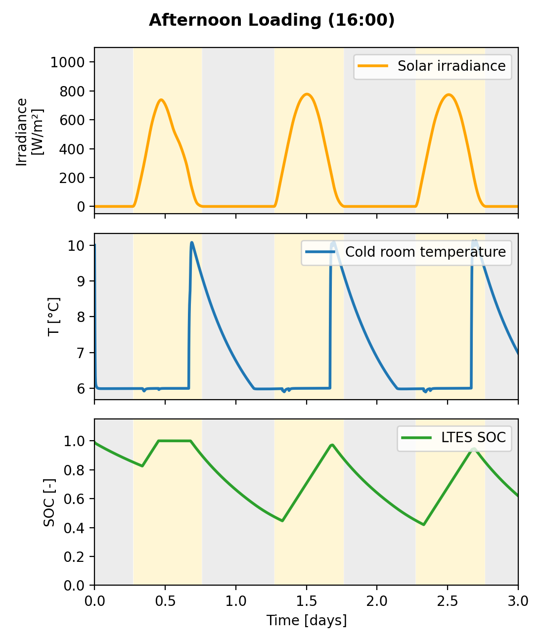

Loading Time Sensitivity
Operating strategy and sizing must be co-designed.
9.63
AGRICOOL

Slide 30
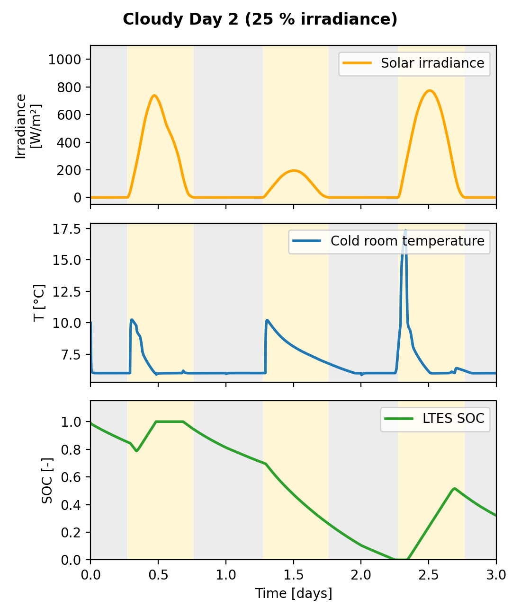
PV Shortfall (Cloudy Day)
Sizing strategy depends on whether the design targets typical or worst-case operation.
9.63
AGRICOOL

Slide 31
What the model helps us understand
Will the cooling system maintain the required temperature, day and night?
Performance changes over time
Solar availability and crop arrival determine when cooling is available and needed.
Components work as a system
Ice storage shifts cooling to later hours. Control coordinates the equipment.
Scenarios support design decisions
AGRICOOL
Compare temperature and storage trajectories, then question the assumptions.
A simulation result is useful when we can explain its behaviors and its limits.

Slide 32
Modelica learning resources
Clickable links for continuing after the session
Modelica by Example
Free online book by Michael Tiller, with equations, connectors and reusable models.
Buildings library tutorial: SimpleHouse
Step-by-step construction of a thermal system using Buildings components.
Buildings library training materials
Workshop exercises and recordings for further practice.
OpenModelica User’s Guide: OMEdit
AGRICOOL
Guidance on editing models, running simulations and plotting results.
Suggested first exercise: run an example, change one parameter, explain the result.

Slide 33



Funded by the European Union. Views and opinions expressed are however those of the author(s) only and do not necessarily reflect those of the European Union or CINEA. Neither the European Union nor the granting authority can be held responsible for them.
Thank you!
www.agricool.eu

Slide 34
A quick review exercise
One minute to think, then share your reasoning.
1. Propose another operating scenario
Which input would you change, while keeping equipment sizing fixed?
What response do you expect, and which plot would you check?
2. Identify a limitation of the model
Which effect or assumption deserves closer attention?
How could it affect the result or a design decision?
AGRICOOL
What would you check before using these results for a real cold room?

